Slide 1
Maroon 6
NOT YOUR TOY!

Slide 2
Maroon 6 Team
Dave - Leader/Project manager
Lydia – Progress Documentation and Coordinator
Shalini - Programmer and Tester
Maksim - Github Manager
Wyan - Technical Documenter
Andres – Programmer and shaper

Slide 3
Coming up with ideas
Wanted to develop a game that encourages team work for young children
Wanted the game to have a story to it
A normal sausage dog that has been turned into a slinky dog by an evil wizard so that his baby dragon has a toy to play with.
Toy dog must collect enough coins to turn back into a real dog

Slide 4
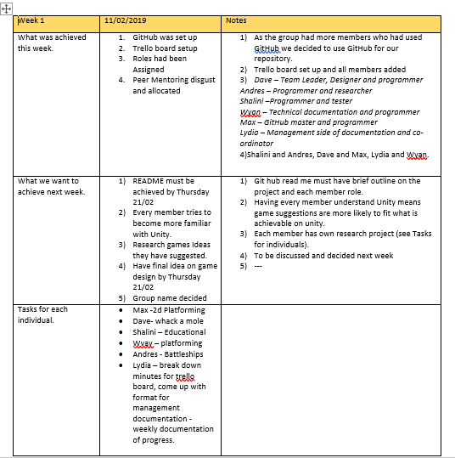
Monitoring progress
Trello
Github
Weekly meeting with minutes
Weekly Progress reports

Slide 5
USP
Teamwork
The game requires 2 players to work together to navigate through the game using both the front and the back of the slinky dog whilst being connected.
Can also be a single player game where the player has control over the front and back of the dog.

Slide 6
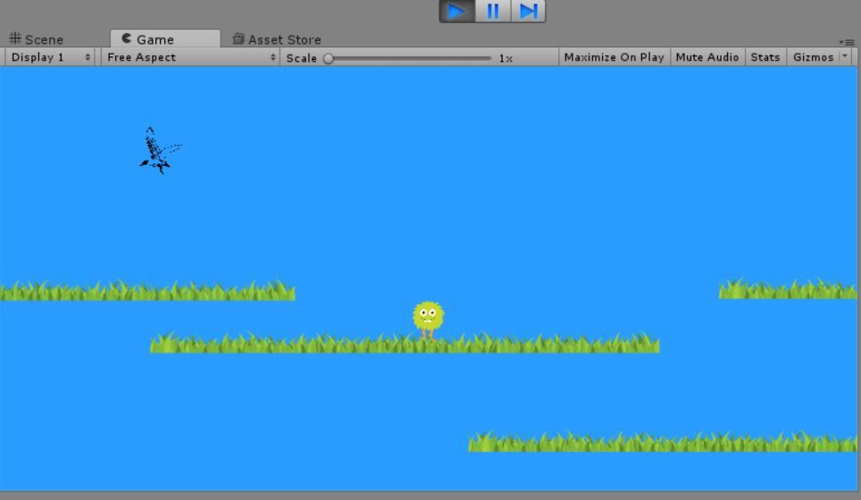
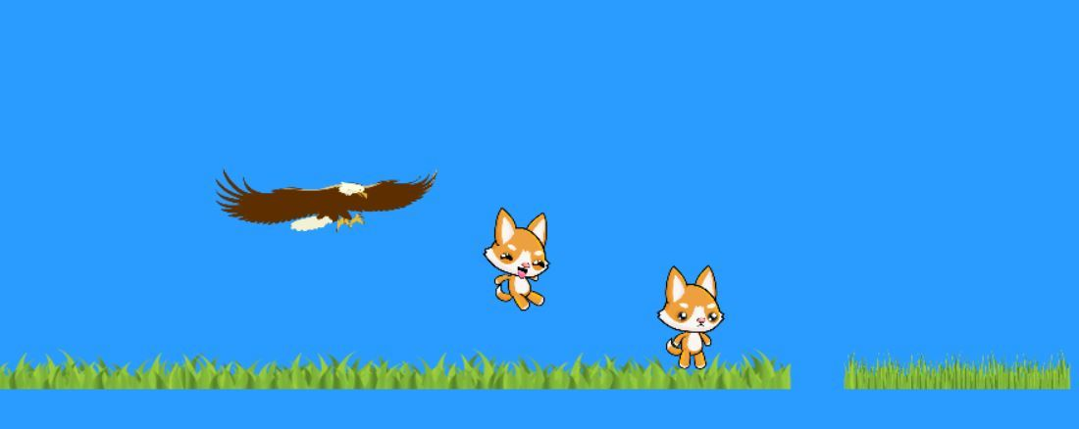
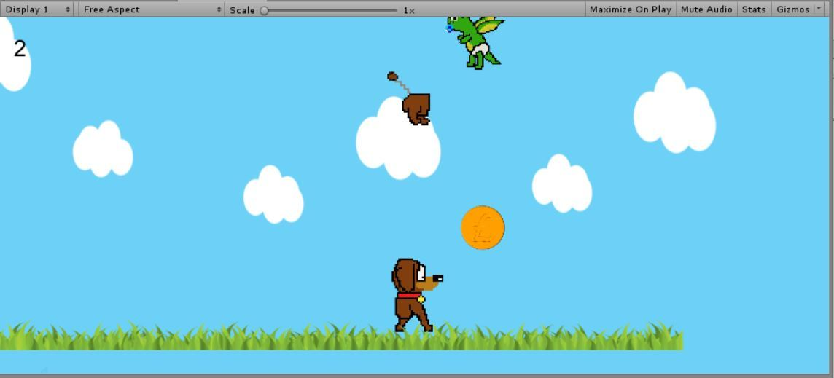
Unity Game development
Two player concept implemented
Attached spring joint 2D
Player 1 is the focus of the game and camera focus is on him
Theme not implemented
Scrolling background implemented
Slinky dog implemented
Dragons are moving
Scoring implemented
Coins can be collected
Games works!
Basic Platform concept is introduced
Enemies characters and platforms created

Slide 7
Strengths and weaknesses- What we would do differently
Weaknesses
Everyone had a different version of unity
Trello not used enough, most communication took place on whatsapp group
Wanted to do more- time and experience stress
Strengths
Original graphic and design
Double player

Slide 8
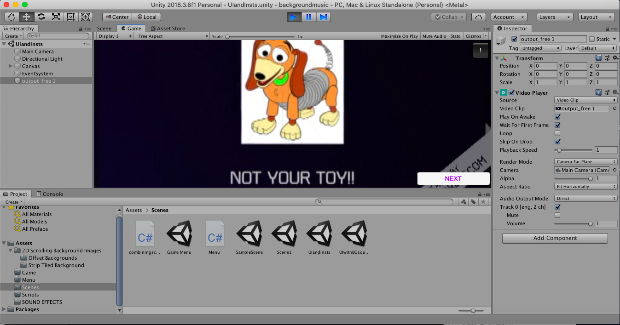
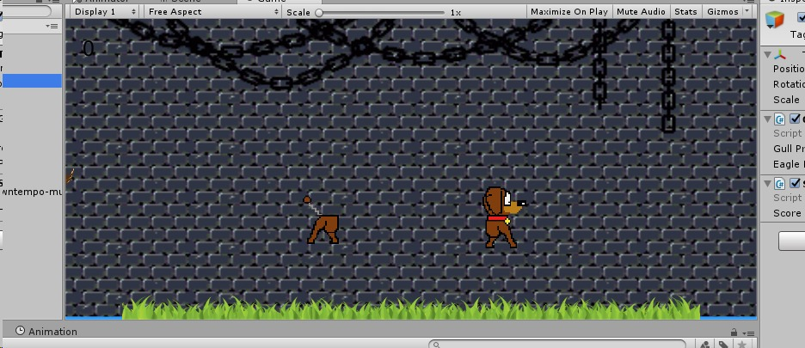
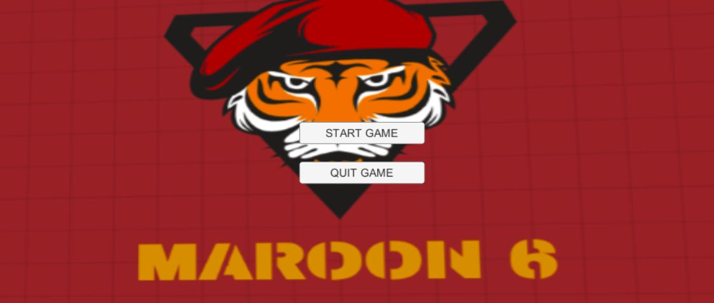
Final product

